Slide 1
5 REASONS EVERY BUSINESS NEEDS A SOCIAL MEDIA STRATEGY
PRESENTED BY SOCIAL MEDIA MARKETING UNIVERSITY
WWW.SMMU.COM

Slide 2
SOCIAL MEDIA STRATEGY FOR BUSINESSES
5 REASONS WHY EVERY BUSINESS NEEDS A SOCIAL MEDIA STRATEGY
WHAT IS A SOCIAL MEDIA STRATEGY
A social media strategy is a formal marketing plan that dictates:
How you will manage your brand in social media
Which social sites you will leverage and procedures for each site
What type of content you will share with your audience
How you will respond to mentions, both negative and positive
What audiences you will target
What goals you will leverage social media to achieve
How you will measure and evaluate social media ROI

Slide 3
SOCIAL MEDIA STRATEGY FOR BUSINESSES
5 REASONS WHY EVERY BUSINESS NEEDS A SOCIAL MEDIA STRATEGY
Does your company have a social media strategy in place?
Nearly half of companies don’t.

Slide 4
SOCIAL MEDIA STRATEGY FOR BUSINESSES
5 REASONS WHY EVERY BUSINESS NEEDS A SOCIAL MEDIA STRATEGY
44% of companies still don’t have a formal social media strategy in place.
Source: SMMU State of the Industry Survey, June 2012

Slide 5
SOCIAL MEDIA STRATEGY FOR BUSINESSES
5 REASONS WHY EVERY BUSINESS NEEDS A SOCIAL MEDIA STRATEGY
“…Most brands know that they have to have a social media presence in order to be competitive in the marketplace, but they still aren’t sure how to navigate the space.”
John Souza, Founder of Social Media Marketing University

Slide 6
SOCIAL MEDIA STRATEGY FOR BUSINESSES
5 REASONS WHY EVERY BUSINESS NEEDS A SOCIAL MEDIA STRATEGY
“Not having a plan in place can greatly hinder a company’s ability to have an impact in social media, and can prevent them from generating results.”
John Souza, Founder of Social Media Marketing University

Slide 7
SOCIAL MEDIA STRATEGY FOR BUSINESSES
5 REASONS WHY EVERY BUSINESS NEEDS A SOCIAL MEDIA STRATEGY
REASONS WHY EVERY BUSINESS NEEDS A SOCIAL MEDIA STRATEGY

Slide 8
SOCIAL MEDIA STRATEGY FOR BUSINESSES
5 REASONS WHY EVERY BUSINESS NEEDS A SOCIAL MEDIA STRATEGY
Social media plans help companies to…
Consistently project an image online that is consistent with their mission and core values.

Slide 9
SOCIAL MEDIA STRATEGY FOR BUSINESSES
5 REASONS WHY EVERY BUSINESS NEEDS A SOCIAL MEDIA STRATEGY
Social media plans help companies to…
Create and share content that reflects the needs and interests of their prospects and customers.

Slide 10
SOCIAL MEDIA STRATEGY FOR BUSINESSES
5 REASONS WHY EVERY BUSINESS NEEDS A SOCIAL MEDIA STRATEGY
Social media plans help companies to…
Build targeted communities.

Slide 11
SOCIAL MEDIA STRATEGY FOR BUSINESSES
5 REASONS WHY EVERY BUSINESS NEEDS A SOCIAL MEDIA STRATEGY
Social media plans help companies to…
Prioritize social media activities that facilitate relationship building and engagement.

Slide 12
SOCIAL MEDIA STRATEGY FOR BUSINESSES
5 REASONS WHY EVERY BUSINESS NEEDS A SOCIAL MEDIA STRATEGY
Social media plans help companies to…
Outline specific social media
goals to facilitate more accurate measurement of ROI.

Slide 13
SOCIAL MEDIA STRATEGY FOR BUSINESSES
5 REASONS WHY EVERY BUSINESS NEEDS A SOCIAL MEDIA STRATEGY
“As social media spending rises, companies are under increased pressure to demonstrate ROI .”
John Souza, Founder of Social Media Marketing University

Slide 14
SOCIAL MEDIA STRATEGY FOR BUSINESSES
5 REASONS WHY EVERY BUSINESS NEEDS A SOCIAL MEDIA STRATEGY
“When you have a plan in place, you can measure your activities against the goals that you’ve set. Additionally, if your campaign isn’t performing well, then you have the data you need to modify your plan to generate better results .”
John Souza, Founder of Social Media Marketing University

Slide 15
SOCIAL MEDIA STRATEGY FOR BUSINESSES
5 REASONS WHY EVERY BUSINESS NEEDS A SOCIAL MEDIA STRATEGY
For more information about SMMU, and to register for social media courses and weekly webinars, visit:
www.smmu.com

Slide 16
SOCIAL MEDIA STRATEGY FOR BUSINESSES
5 REASONS WHY EVERY BUSINESS NEEDS A SOCIAL MEDIA STRATEGY

Slide 17
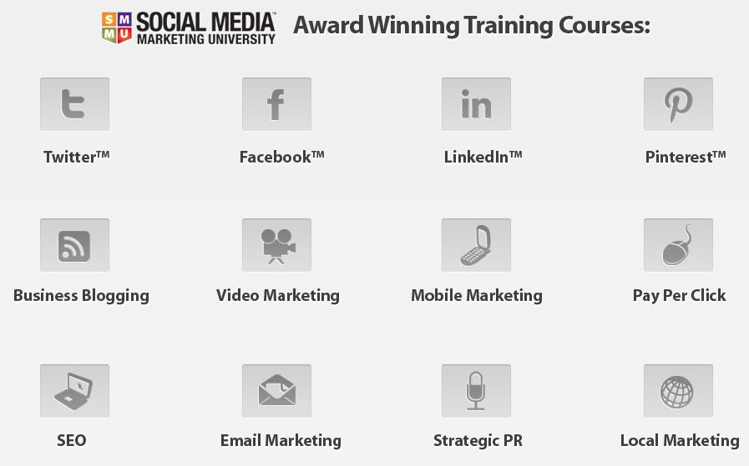
SOCIAL MEDIA STRATEGY FOR BUSINESSES
5 REASONS WHY EVERY BUSINESS NEEDS A SOCIAL MEDIA STRATEGY

Slide 18
SOCIAL MEDIA STRATEGY FOR BUSINESSES
5 REASONS WHY EVERY BUSINESS NEEDS A SOCIAL MEDIA STRATEGY
Follow Us!!!
…for information on social media trends, best practices and more!
www.facebook.com/socialmediamagic
www.twitter.com/smmagic

Slide 19
5 REASONS EVERY BUSINESS NEEDS A SOCIAL MEDIA STRATEGY
PRESENTED BY SOCIAL MEDIA MARKETING UNIVERSITY
WWW.SMMU.COM

